Slide 1
Analysis of domestic college
Instructor:
鄭又仁
Group members:
統計所 朱哲渝
統計所 林書宇
統計所 林敬皓
統計所 劉軒成
科管三 陳庭緯

Slide 2
EDA
01
PCA
02
TABLE OF CONTENTS
Hierarchical
03
04
K-means
05
GMM

Slide 3
01
探索數據分析(EDA)

Slide 4
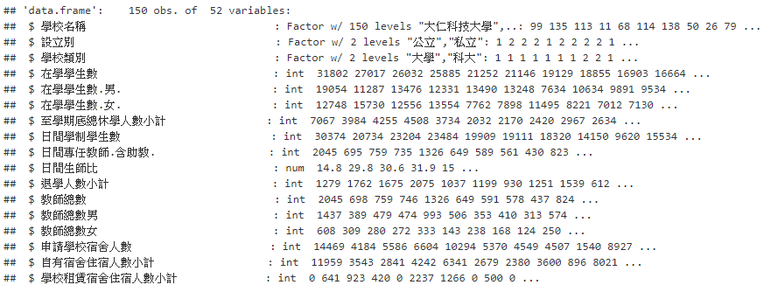
Inspect of the variable
Mercury is the closest planet to the Sun and the smallest one in the Solar System—it’s only a bit larger than our Moon. The planet’s name has nothing to do with the liquid metal, since it was named after the Roman messenger god, Mercury

Slide 5
EDA by shiny

Slide 6
02
Principal Component Analysis

Slide 7

Principal Component Analysis
Principle components是p個隨機變數X1,X2,...,Xp的特定線性組合。這些線性組合代表藉由旋轉原始座標軸(X1,X2,...,Xp)選取的新座標軸，此新座標軸可以表達出最大變異的方向，而且提供covariance structure一個更簡單簡潔的描述。
Principle components只與X1,X2,...,Xp covariance matrix(或是correlation matrix)有關，他們不需要多維常態假設。

Slide 8
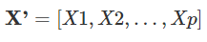
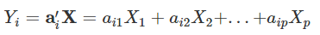
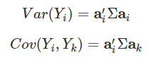
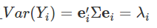
假設隨機向量
共變異數矩陣Σ的eigenvalue為λ1≥λ2≥...≥λp≥0 對於線性組合
我們知道
Principal components就是這些獨立的線性組合Y1,Y2,...,Yp，且Var(Yi)已最大化。 在理論推導下，可以知道 就是第i個principal component，且

Slide 9
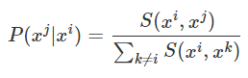
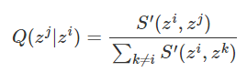
t-distributed stochastic neighbor embedding
t-SNE是一種非線性的降維方法，考慮從高維度的資料x轉換到低維度的資料z
時，比較不同資料點間的“相似程度”:S(xi,xj)S(xi,xj)，先進行normalization得
對於低維度資料z也可計算S′(zi,zj)以及
進行normalization是因為我們不知道高維的距離計算S與低維的距離計算S′算出來的scale是否一致；且進行變換後，我們便可將其距離轉換為機率。

Slide 10
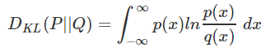
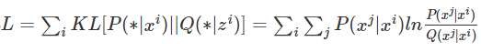
接下來，我們的目標就是尋找zi,zjzi,zj使得P(xj|xi)P(xj|xi)的分布與Q(zj|zi)Q(zj|zi)的分布越接近越好。衡量兩個分布之間的相似程度，我們會使用Kullback-Leibler divergence
我們的目標就是尋找z的集合，使得
越小越好。
為了達成此目的，我們僅需利用gradient descent即可。

Slide 11
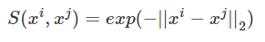
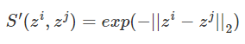
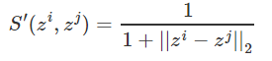
Similarity S(∗)的選擇 SNE與t-SNE
我們在高維度的x資料點上，similarity的選擇是使用逕向基函數(radial basis function)
先計算xi與xj的歐式距離，再進行轉換。這可以確保在非常相近的點才有值，相距較遠的點就會變得很小。
SNE在高維與低維都同樣選用相同的similarity
但t-SNE在低維度的similarity選擇為
是t(1)也就是Cauchy(0,1)。

Slide 12
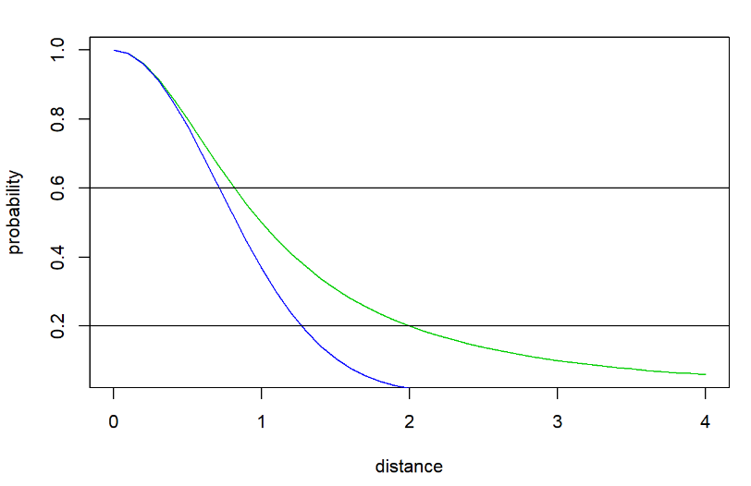
上圖的綠色為Cauchy distribution，藍色為Gaussian distribution，假設x軸就是||xi−xj||2和||zi−zj||2，我們做完降維後想要保持相近的P(xj|xi)與Q(zj|zi)，也就是畫出水平線。我們可以發現當高維度相近的兩個點(distance小)在投影到低維度時(從藍色線延著水平線到綠色線)，對應下來的distaance還是小的。但當高維度距離遠的兩點(distance大)在投影到低維度時(從藍色線延著水平線到綠色線)，對應下來的distance因為heavy tail的關係被拉大了!
因此t-SNE除了可以把相近的點表現在一起之外，還可以把相遠的點強化變得更遠。

Slide 13
PCA by shiny

Slide 14
03
Hierarchical Clustering

Slide 15



Method
NO lables NO specified K’s
Dendrogram
Earlier fusion More similar

Slide 16
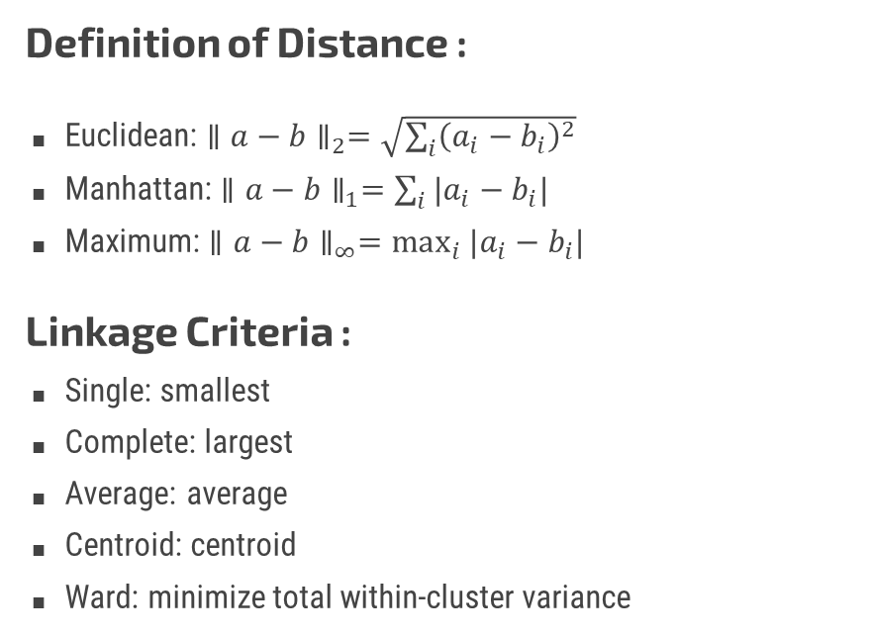
Method
Definition of Distance :
Euclidean: $∥a−b∥_{2}=\sqrt{\sum_{i}{{\left(a_{i}−b_{i}\right)}^{2}}}$
Manhattan: $∥a−b∥_{1}=\sum_{i}{|a_{i}−b_{i}|}$
Maximum: $∥a−b∥_{∞}=\max_{i}{|a_{i}−b_{i}|}$
Linkage Criteria :
Single: smallest
Complete: largest
Average: average
Centroid: centroid
Ward: minimize total within-cluster variance

Slide 17
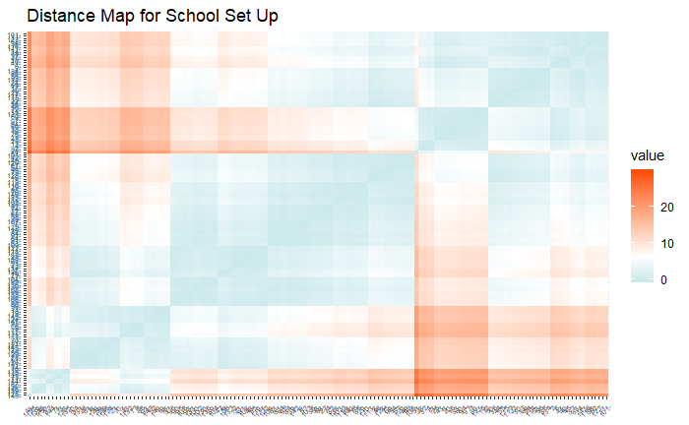
School Set Up
Variables Considered: 1. 學生老師比 2. 退學率 3. 休學率 4. 註冊率 5. 弱勢學生比率

Slide 18
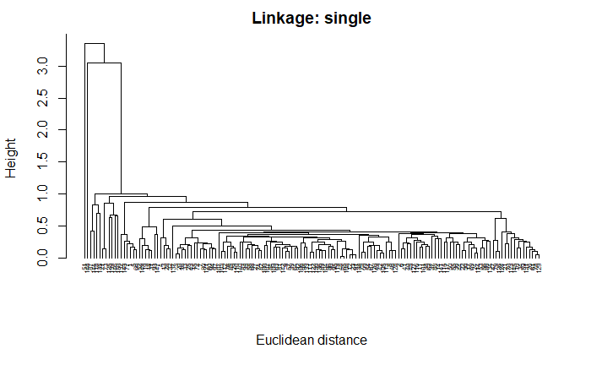
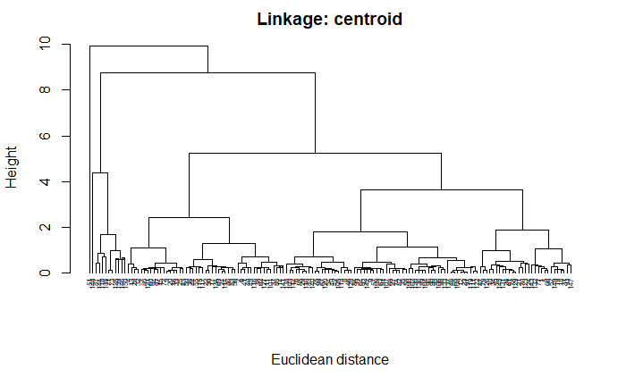
School Set Up
大者恆大

Slide 19
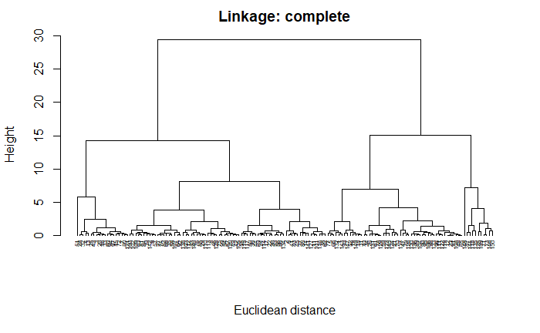
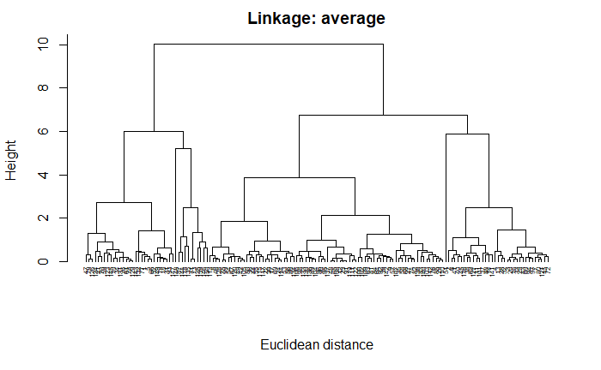
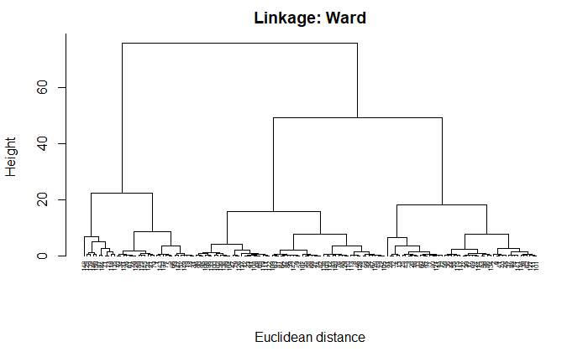
School Set Up
齊頭並進

Slide 20
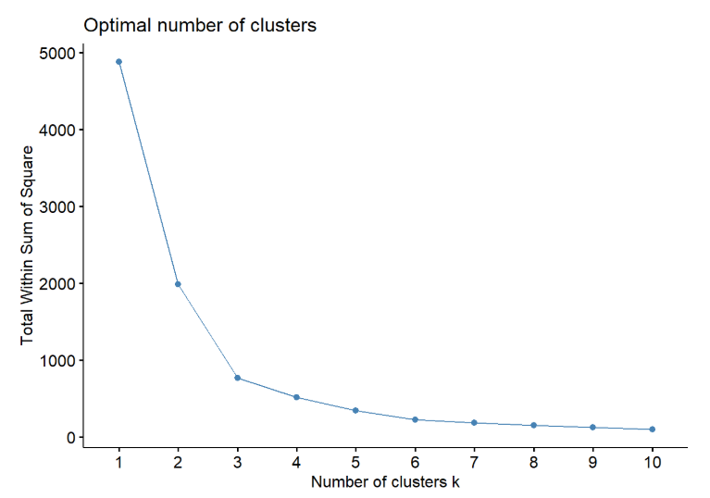
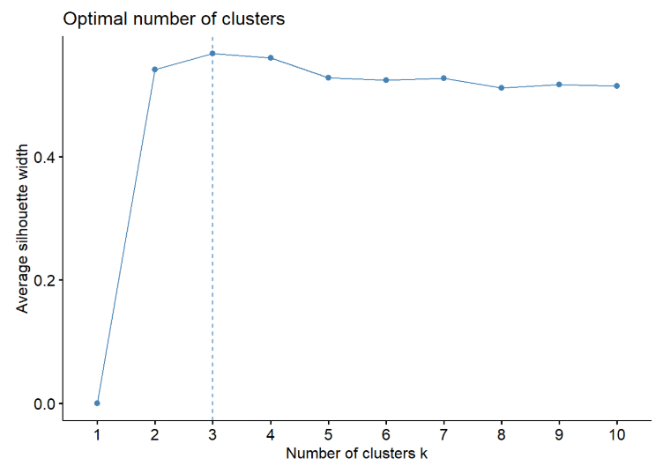
School Set Up
Elbow method
Average Silhouette method

Slide 21
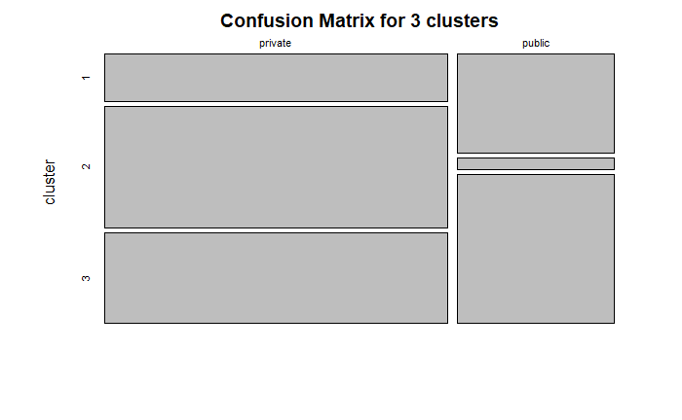
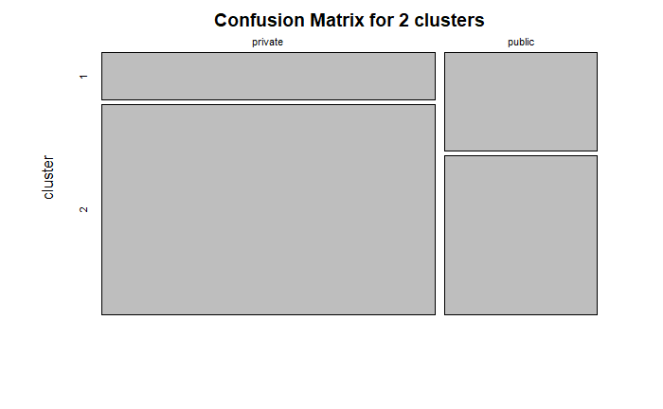
School Set Up

Slide 22
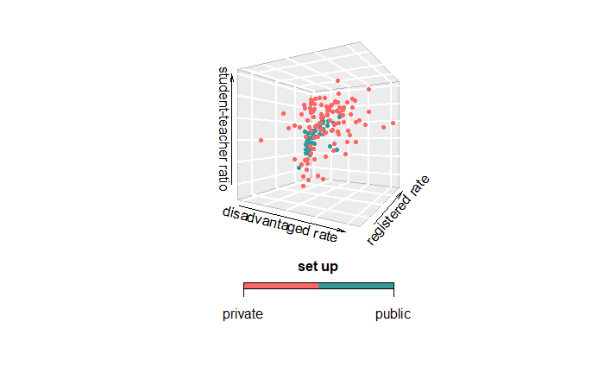
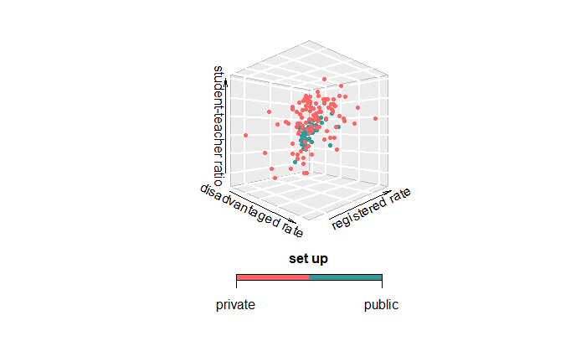
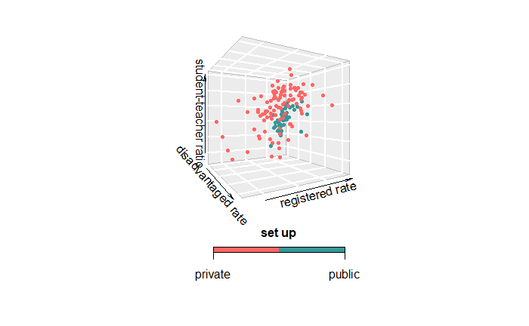
School Set Up
True distribution

Slide 23
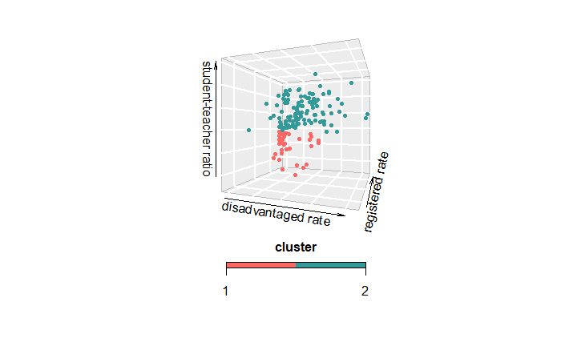
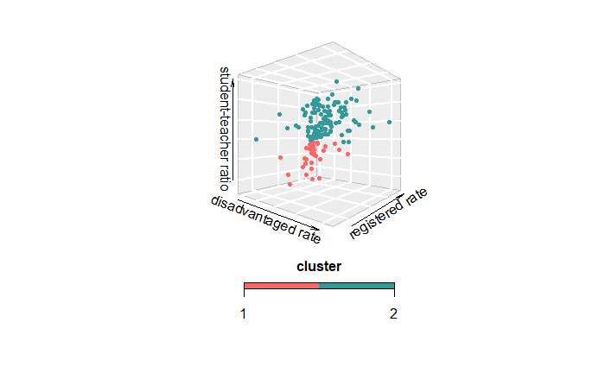
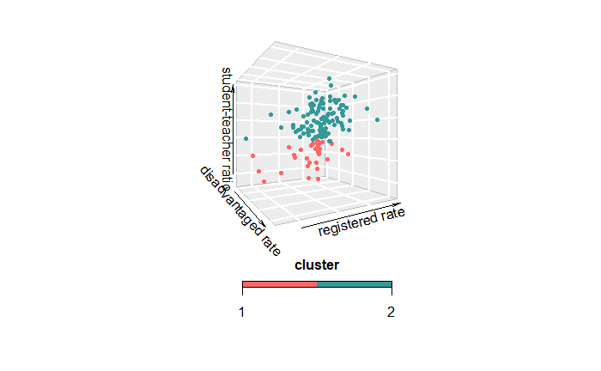
School Set Up
2 Clusters

Slide 24
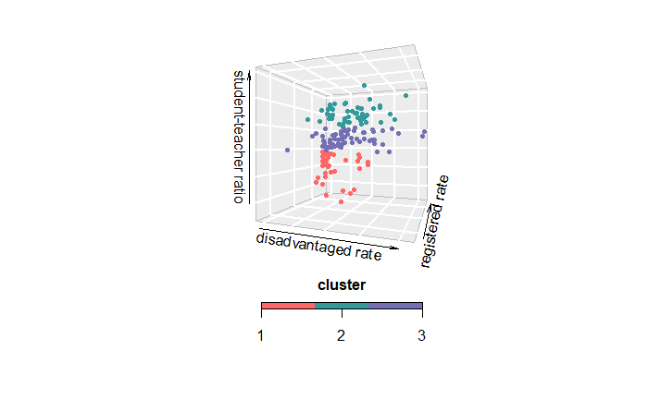
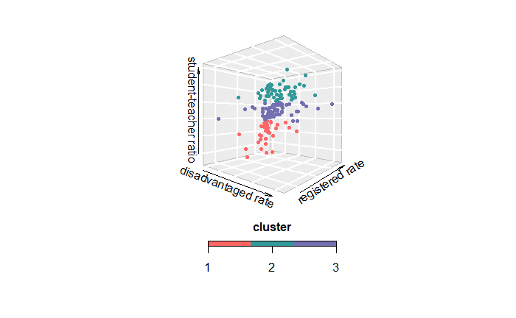
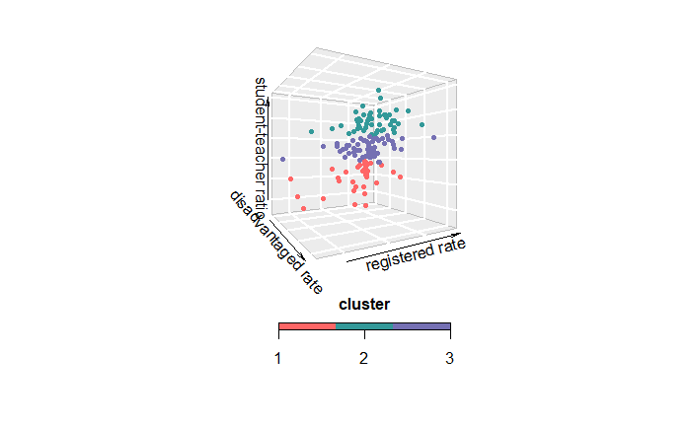
School Set Up
3 Clusters

Slide 25
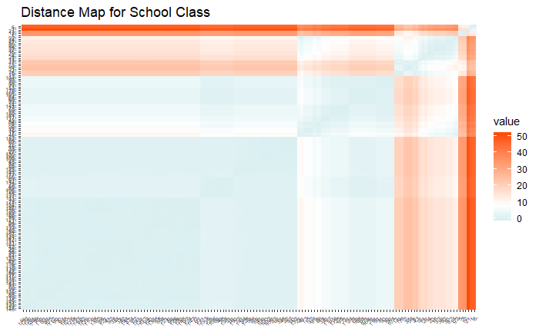
School Class
Variables Considered: 1. 與國外學校學位合作數 2. 申請宿舍比率 3. 外籍教師比率 4. 僑生比率 5. 雙主修學生比率 6. 輔系學生比率 7. 跨校選課比率 8. 出國進修學生比率 9. 弱勢學生比率

Slide 26
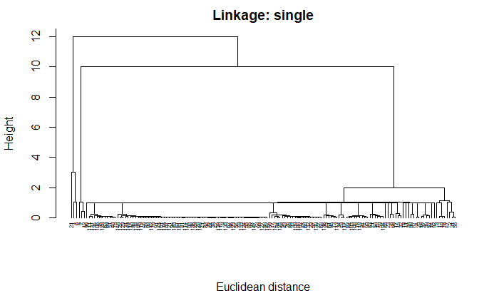
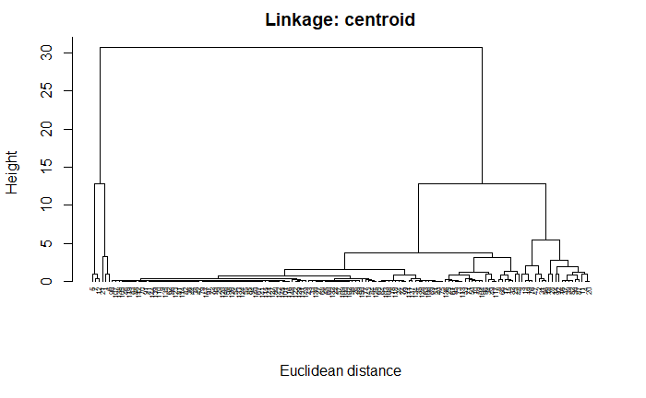
School Class

Slide 27
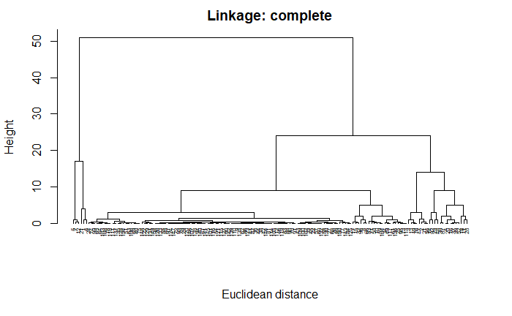
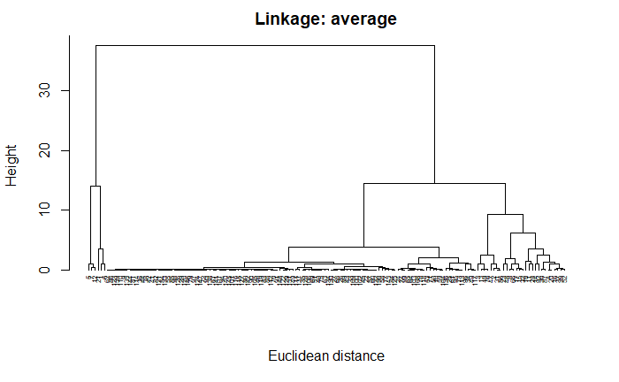
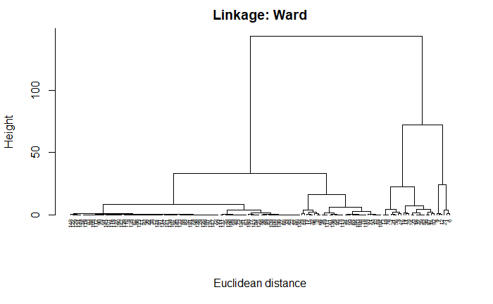
School Class

Slide 28
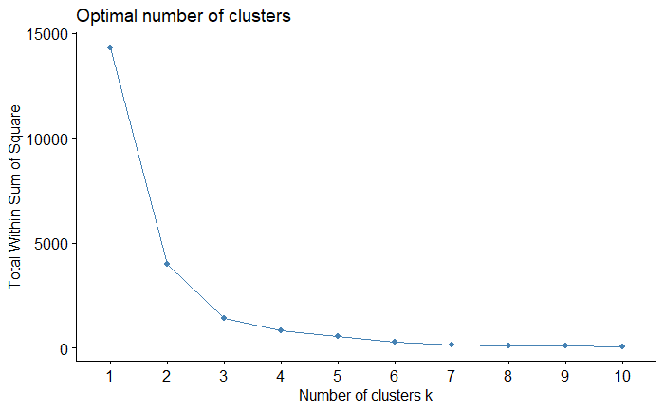
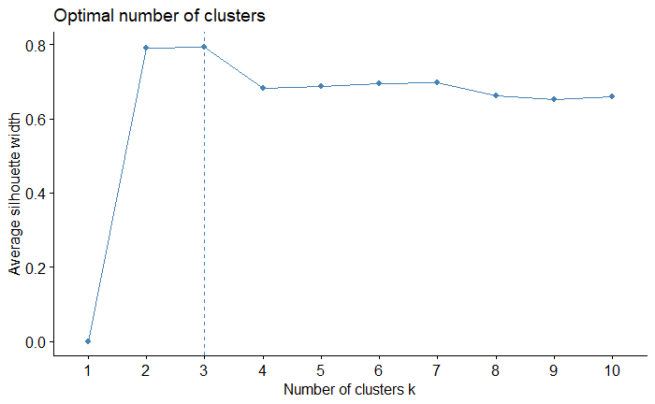
School Class
Elbow method
Average Silhouette method

Slide 29
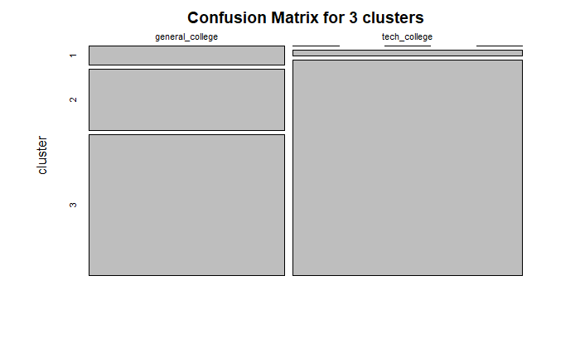
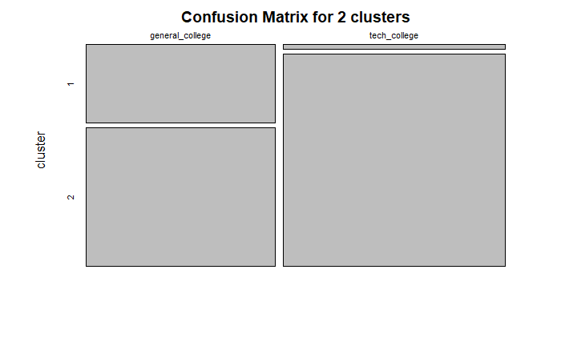
School Class

Slide 30
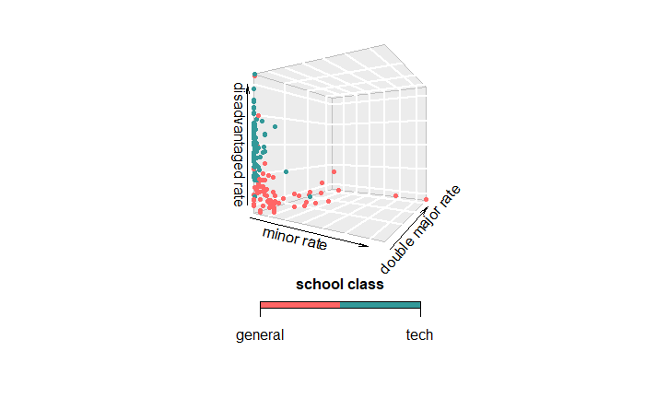
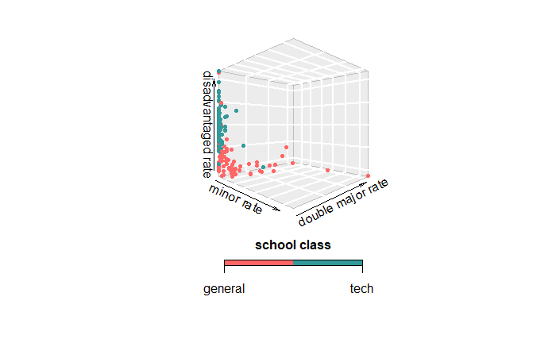
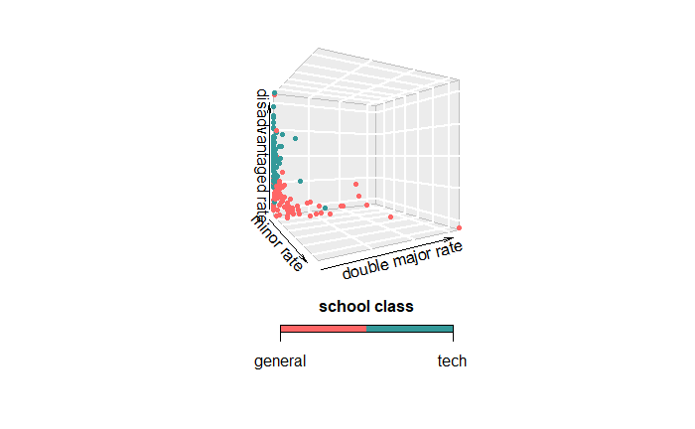
School Class
True distribution

Slide 31
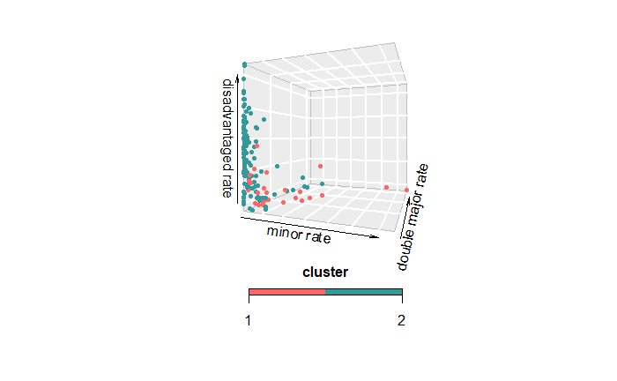
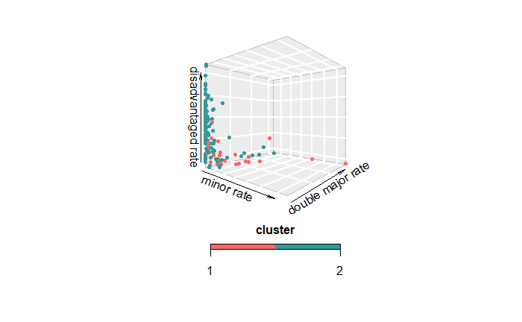
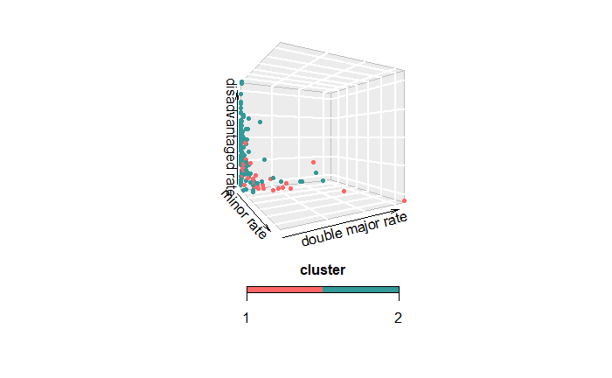
School Class
2 Clusters

Slide 32
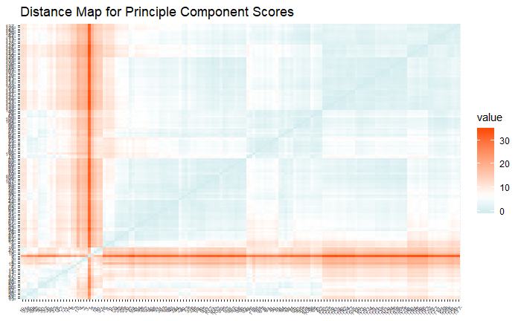
After Principle Component Analysis
Variables Considered: 1. PC score 1 2. PC score 2 3. PC score 3

Slide 33


After PCA

Slide 34



After PCA

Slide 35


After PCA
Elbow method
Average Silhouette method

Slide 36



After PCA
True distribution for school set up

Slide 37



After PCA
True distribution for school class

Slide 38



After PCA
2 Clusters

Slide 39
04
K-means Clustering

Slide 40

K-means Introduction
Unsupervised Learning
Model:
Advantage:
Relatively simple to implement.
Scales to large data sets.
Guarantees convergence.
Disadvantage:
Choose K manually
Being dependent on initial value.
Clustering outliers.

Slide 41


K-means School Set_up
Original Data
ACC=0.7

Slide 42


K-means School_class
Original Data
ACC=0.647

Slide 43


K-means School Set_up
Use the result from EDA
ACC=0.627

Slide 44


K-means School_class
Use the result from EDA
ACC =0.7067

Slide 45
K-means by shiny

Slide 46

K-means After PCA
Real Distribution
Set_up
Real Distribution
School_class
ACC=0.687
ACC=0.673
K-means

Slide 47
ACCURACY COMPARING TABLE
 | Original Data |  | PCA
Accuracy (public/private) | 0.64 |  | 0.687
Accuracy (general/tech) | 0.627 |  | 0.673

Slide 48
05
Gaussian Mixture Model

Slide 49

Two-Component of Gaussian Mixture Model .
Suppose that 𝑌 follows a mixture of two normal distributions:
where △ ∈ {0,1}with 𝑃𝑟(△ = 1) = 𝜋

Slide 50

Two-Component of Gaussian Mixture Model
Then the density of 𝑌 is
with parameters
The(observed data)log-likelihood based on training data with sample size n is

Slide 51

Two-Component of Gaussian Mixture Model
If △ 𝑖 = 1then 𝑌 𝑖 comes from 𝜙 𝜂 2 (𝑦 𝑖 ),otherwise it comes from 𝜙 𝜂 1 (𝑦 𝑖 ).
Suppose we knew the values of the △ 𝑖 ’s,the complete data log-likelihood would be

Slide 52

EM Algorithm for Two-Component of Gaussian Mixture Model

Slide 53

EM Algorithm for Two-Component of Gaussian Mixture Model

Slide 54

EM Algorithm for Two-Component of Gaussian Mixture Model

Slide 55

Check the normality assumption

Slide 56


Set_up Clustering Case1.全部的變數和只挑一個變數

Slide 57

Case2.挑EDA變數

Slide 58




Case3.挑一個變數模擬

Slide 59

Case 4. 挑EDA 中3 個變數模擬

Slide 60


Clustering for School Class Case1.全部的變數和只挑一個變數

Slide 61

Case2.挑EDA變數

Slide 62




Case 3. 挑一個變數模擬

Slide 63

Case4.挑EDA3個變數模擬

Slide 64
Thanks for listening

